Slide 1


Data Science
Teacher: Dr Muhammad Ismail Mangrio
  ismail@iba-suk.edu.pk
Week 1

Slide 2
Course Objectives
This course aims to provide students with a foundational understanding of key concepts, techniques, and tools used in the field of data science using the Python programming language.
To cater to individuals who are new to data science.
By the end of the course, participants should be able to:
  Understand Data Science Fundamentals: Gain a clear grasp of the fundamental concepts of data science, including data manipulation, exploration, analysis, and visualization.
  Learn Python Programming: Acquire essential Python programming skills required for data manipulation, analysis, and visualization. Participants will learn how to work with Python libraries commonly used in data science, such as NumPy, pandas, and matplotlib.

Slide 3
Course Objectives
  Data Cleaning and Preprocessing: Learn techniques to clean, preprocess, and transform raw data into a format suitable for analysis. This includes handling missing values, dealing with outliers, and converting data types.
  Exploratory Data Analysis (EDA): Develop the ability to perform exploratory data analysis to uncover patterns, trends, and insights in data. Participants will learn how to create various types of plots and visualizations to aid in understanding data.

Slide 4
Course structure
Unit 01: Python for Data Science
Data types, functions, Jupyter, classes, objects, functional programming, numpy, scipy, matplotlib & pandas
Estimated time: 3 weeks
Unit 02: Data Science
Exploring Data Science with its implementation in Python programming language
Estimated time: 12 weeks

Slide 5
Prerequisites
I assume that you have some background in programming and statistics
Come speak to me if:
this is your first programming course
you have never taken a probability or statistics course
This course is probably not for you if:
you have no programming background

Slide 6
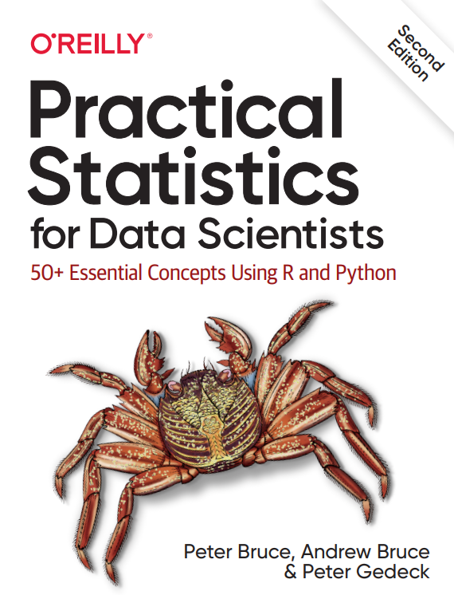
Course information
Textbooks for Data Science:
Practical Statistics for Data Scientists By by Peter Bruce, Andrew Bruce, and Peter Gedeck
Introduction to Data Science By Davy Cielen
Textbooks and links for Python:
Python for Data Analysis by Wes McKinney
w3schools
geeksforgeeks
ProgrammingwithMosh

Slide 7
Commitment
Weekly 3-hour lectures
Credit hours are (3+0)
Rest of time spent:
  Following links in the slides, reading book
  Background reading
  Using the material/exercises provided on LMS

Slide 8
Tentative marks distribution
Description | Marks
Total marks | 100
Final examinations | 50
Mid term examinations | 30
Practical Home Tasks | 5
Class Tasks Performance and Behavior | 5
Quiz | 5
Project / Presentation | 5

Slide 9
Course information
Enrollment on elearning:
Every student has to enroll themselves on elearning in the 1st week
See Data Science course on elearning at:
https://elearning.iba-suk.edu.pk/course/view.php?id=943

Slide 10
Late no more than 5 minutes
Major fine (financial or absence on CMS) will be imposed if you are late more than 5 minutes in the classroom

Slide 11
About Me
B.E. Pakistan, 2011
M.S. Myongji University, South Korea, 2016
Associate Fellow HEA (AFHEA), 2021
PhD, 2023
Areas of Research
  Computational intelligence, fuzzy systems
  Image super resolution, ML
Office
  CS Coordinator Office, Room # 08, AB-I

Slide 12

Introduce Yourself

Slide 13
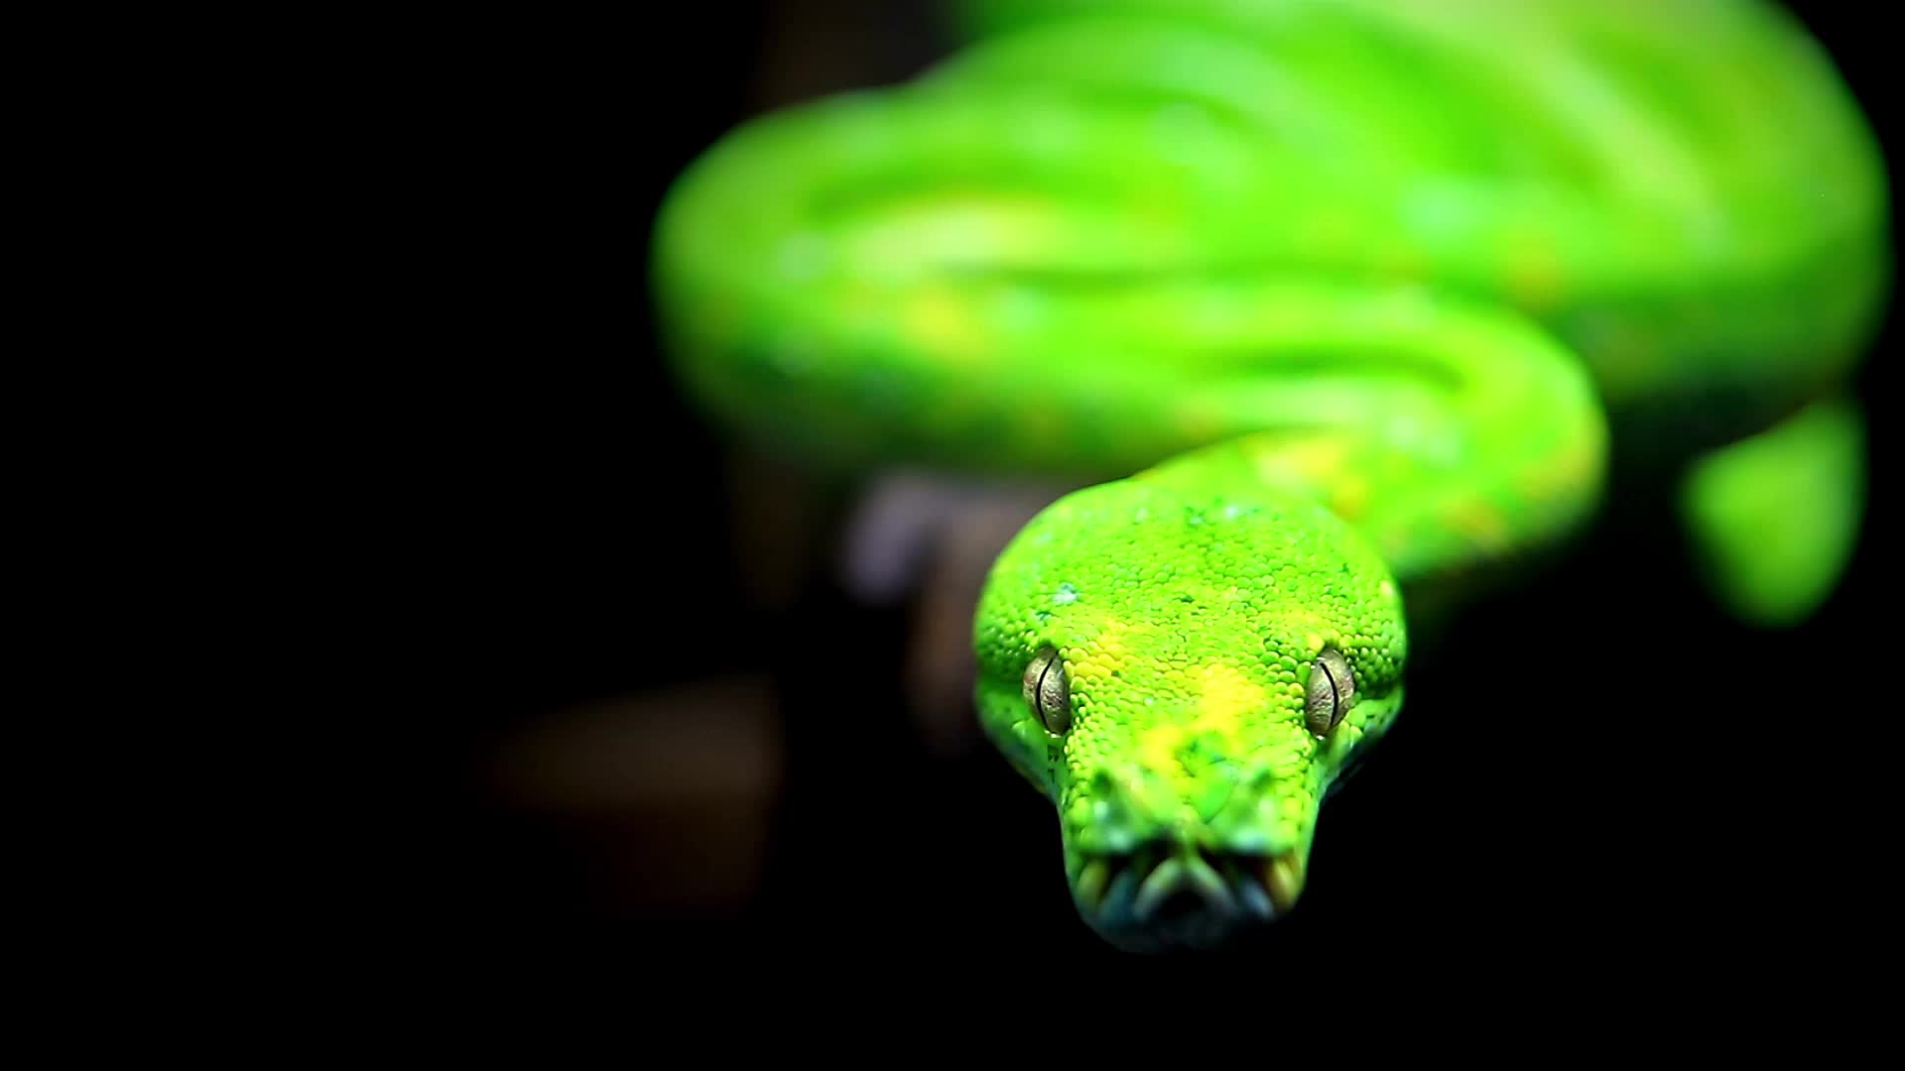
Lecture 1: Python for Data Science

Slide 14

Why Python for Data Science
Python in Data Science
  Used for data analysis, interactive computing, and visualization
  Often compared with R, MATLAB, SAS, Stata, etc.
Why Python is Popular
  Strong libraries: pandas, scikit-learn, numpy, and more
  Easy to learn and versatile
  Suitable for both data tasks and full-scale applications
Image credit: https://www.python.org/community/logos/

Slide 15
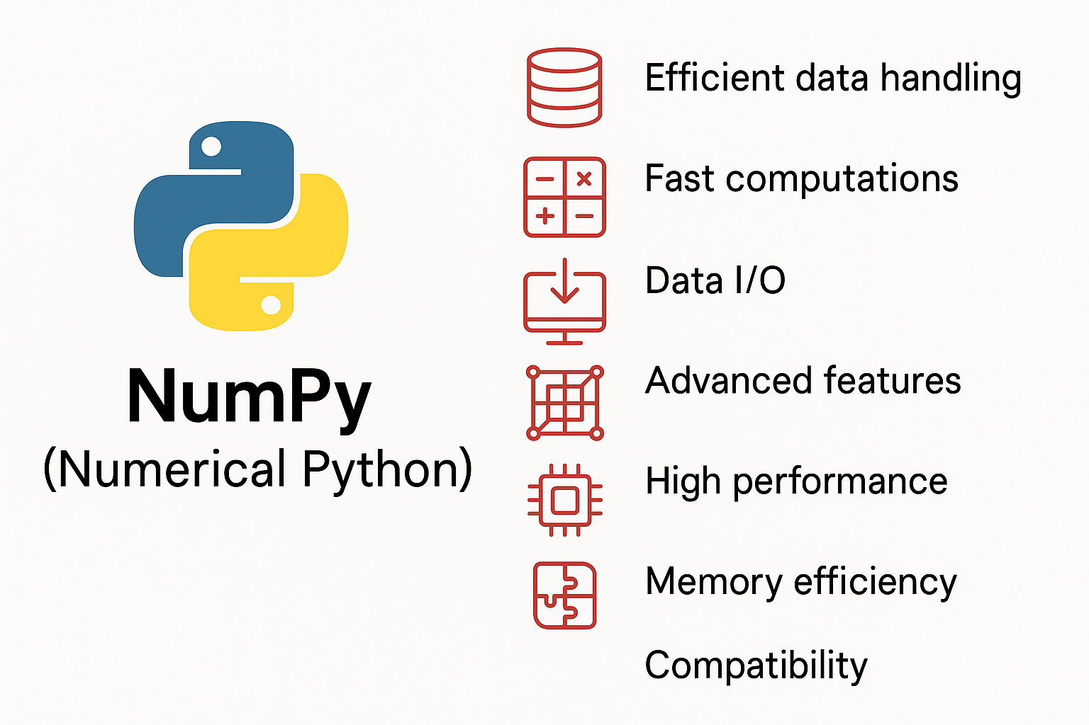
Python Libraries for this course
NumPy (Numerical Python):
Efficient data handling with multidimensional arrays (ndarray)
Fast computations: element-wise & mathematical operations
Data I/O: read/write array datasets to disk
Advanced features: linear algebra, Fourier transform, random numbers
High performance: C API for integration with C/C++
Memory efficiency: better than built-in Python structures for numerical data
Compatibility: works directly with C/Fortran libraries without extra copying

Slide 16
Python Libraries for this course
Pandas
High-level data structures for structured/tabular data
Fast, easy, and expressive data handling
Combines NumPy’s performance with spreadsheet/SQL flexibility
Powerful indexing for reshaping, slicing, aggregations, and subsetting
Ideal for data cleaning, preparation, and manipulation

Slide 17
Python Libraries for this course
Matplotlib
Most popular Python library for 2D data visualizations
Creates publication-quality plots
Widely used and considered the default visualization tool in Python
Supports a variety of chart types (line, bar, scatter, etc.)

Slide 18
Python Libraries for this course
scikit-learn
Leading machine learning toolkit for Python
1,500+ contributors worldwide
Key modules:
  Classification: SVM, k-NN, random forest, logistic regression
  Regression: Lasso, ridge regression
  Clustering: k-means, spectral clustering
  Dimensionality reduction: PCA, feature selection, matrix factorization
  Model selection: Grid search, cross-validation, metrics
  Preprocessing: Feature extraction, normalization

Slide 19
Python 2 and Python 3
Python 2.x reached its development end of life in 2020 (including critical security patches), and so it is no longer a good idea to start new projects in Python 2.7.
Therefore, use Python 3.12 (3.9/3.10/3.11), a widely deployed, well-supported stable release.

Slide 20

Integrated Development Environments (IDEs) and Text Editors
Pick an editor/IDE for python
or just use a text editor, or just write directly in jupyter
Here are some that you can explore:
  • PyDev (free), an IDE built on the Eclipse platform
  • PyCharm from JetBrains (subscription-based for commercial users, free for open
  source developers)
  • Python Tools for Visual Studio (for Windows users)
  • Spyder (free), an IDE currently shipped with Anaconda
  • Komodo IDE (commercial)
Note: we will use only Python 3 in this course. Check that you have Python 3 installed on your machine and that it is running properly.

Slide 21

Integrated Development Environments (IDEs) and Text Editors
Anaconda Navigator (Installed in the Computers of AB-01)
Anaconda Navigator is a desktop graphical user interface (GUI) included in Anaconda distribution that allows users to launch applications and manage conda packages, environments and channels without using command-line commands. Navigator can search for packages on Anaconda Cloud or in a local Anaconda Repository, install them in an environment, run the packages and update them. It is available for Windows, macOS and Linux. The following applications are default in Navigator:
  JupyterLab
  Jupyter Notebook
  QtConsole
  Spyder
  Glue
  Orange
  RStudio
  Visual Studio Code
Note: we will use only Python 3 in this course. Check that you have Python 3 installed on your machine and that it is running properly.

Slide 22
Integrated Development Environments (IDEs) and Text Editors
Several options for running Python on your computer Python interpreter
Jupyter: https://jupyter.org/
You can also used Google Colab
If you need GPUs hours then use Google CoLab
https://colab.research.google.com/
Note: we will use only Python 3 in this course. Check that you have Python 3 installed on your machine and that it is running properly.

Slide 23

Python: Overview
Python is a dynamically typed, interpreted programming language Created by Guido van Rossum in 1991
Maintained by the Python Software Foundation
In many languages, when you declare a variable, you must specify the variable’s type (e.g., int, double, Boolean, string).
Python does not require this.
Design philosophy: simple, readable code
Python syntax differs from R, Java, C/C++, MATLAB whitespace delimited
limited use of brackets, semicolons, etc

Slide 24

Python: Overview
Python is a dynamically typed, interpreted programming language Created by Guido van Rossum in 1991
Maintained by the Python Software Foundation
Some languages (e.g., C/C++ and Java) are compiled: we write code, from which we get a runnable program via compilation. In contrast, Python is interpreted: A program, called the interpreter, runs our code directly, line by line.
Design philosophy: simple, readable code
Python syntax differs from R, Java, C/C++, MATLAB whitespace delimited
limited use of brackets, semicolons, etc
Compiled vs interpreted languages: compiled languages are (generally) faster than interpreted languages, typically at the cost of being more complicated.

Slide 25
Python Interpreter on the Command Line
keith@Steinhaus:~/demo$ python3
Python 3.6.3 (default, Oct 4 2017, 06:09:05)
[GCC 4.2.1 Compatible Apple LLVM 8.0.0 (clang-800.0.42.1)] on darwin Type "help", "copyright", "credits" or "license" for more information.
>>>
keith@Steinhaus:~/demo$ python
Python 2.7.13 |Anaconda 4.4.0 (x86_64)| (default, Dec 20 2016, 23:05:08) [GCC 4.2.1 Compatible Apple LLVM 6.0 (clang-600.0.57)] on darwin
Type "help", "copyright", "credits" or "license" for more information. Anaconda is brought to you by Continuum Analytics.
Please check out: http://continuum.io/thanks and https://anaconda.org
>>>

Slide 26
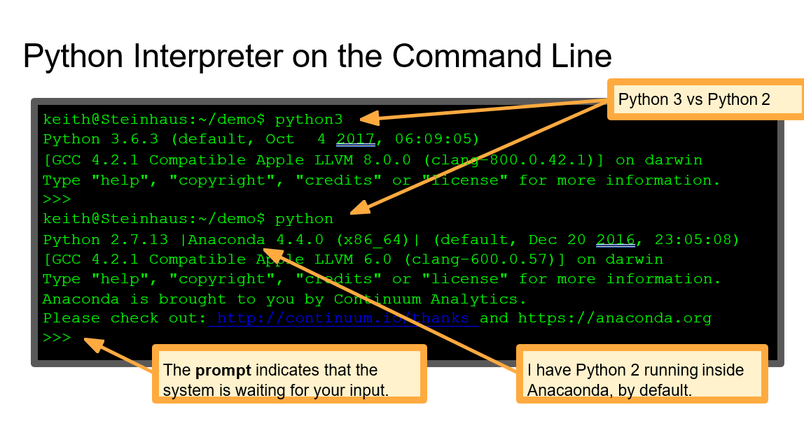

Slide 27


Python Interpreter on the Command Line
keith@Steinhaus:~/demo$ python3
Python 3.6.3 (default, Oct 4 2017, 06:09:05)
[GCC 4.2.1 Compatible Apple LLVM 8.0.0 (clang-800.0.42.1)] on darwin Type "help", "copyright", "credits" or "license" for more information.
>>>
keith@Steinhaus:~/demo$ python
Write Python commands (code) at the prompt
Notes:
Python 2.7.13 |Anaconda 4.4.0 (x86_64)| (default, Dec 20 2016, 23:05:08) [GCC 4.2.1 Compatible Apple LLVM 6.0 (clang-600.0.57)] on darwin
Type "help", "copyright", "credits" or "license" for more information. Anaconda is brought to you by Continuum Analytics.
Please check out: http://continuum.io/thanks and https://anaconda.org
>>>

Slide 28
Running Jupyter
keith@Steinhaus:~/demo$ jupyter notebook [I 17:11:41.129 NotebookApp] Serving notebooks from local directory: /Users/keith/Dropbox/Academe/Teaching/STATS507/Lecs/L1_AdminIntro [I 17:11:41.129 NotebookApp] 0 active kernels [I 17:11:41.129 NotebookApp] The Jupyter Notebook is running at: http://localhost:8888/?token=452d6d4b227f306f5bb57e72f5d4722fcbadf47d1d794441 [I 17:11:41.129 NotebookApp] Use Control-C to stop this server and shut down all kernels (twice to skip confirmation). [C 17:11:41.132 NotebookApp] Copy/paste this URL into your browser when you connect for the first time, to login with a token: http://localhost:8888/?token=452d6d4b227f306f5bb57e72f5d4722fcbadf47d1d794441 [I 17:11:41.635 NotebookApp] Accepting one-time-token-authenticated connection from ::1
 | Jupyter provides some information about its startup process, and then...

Slide 29
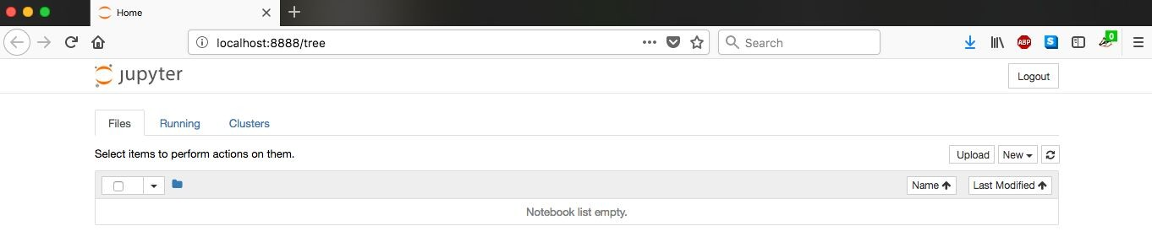
Running Jupyter
keith@Steinhaus:~/demo$ jupyter notebook
[I 17:11:41.129 NotebookApp] Serving notebooks from local directory:
/Users/keith/Dropbox/Academe/Teaching/STATS507/Lecs/L1_AdminIntro [I 17:11:41.129 NotebookApp] 0 active kernels
[I 17:11:41.129 NotebookApp] The Jupyter Notebook is running at: http://localhost:8888/?token=452d6d4b227f306f5bb57e72f5d4722fcbadf47d1d794441 [I 17:11:41.129 NotebookApp] Use Control-C to stop this server and shut down all
kernels (twice to skip confirmation). [C 17:11:41.132 NotebookApp]
...Jupyter opens a browser window in which you can launch a new notebook or open an existing one.
Copy/paste this URL into your browser when you connect for the first time,
to login with a token: http://localhost:8888/?token=452d6d4b227f306f5bb57e72f5d4722fcbadf47d1d794441
[I 17:11:41.635 NotebookApp] Accepting one-time-token-authenticated connection from
::1

Slide 30

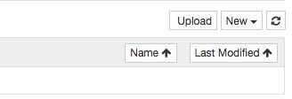
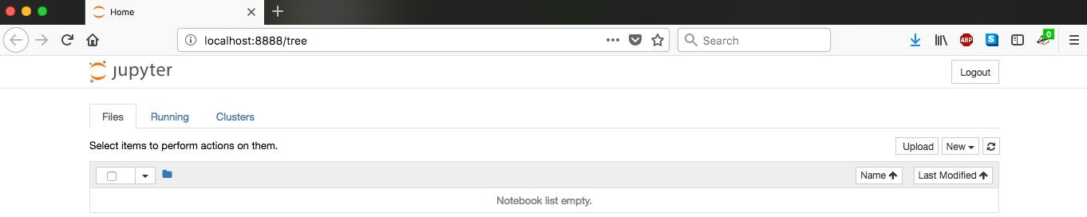

Slide 31

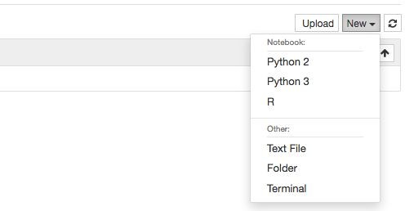



Creates a new notebook file running Python 2.
Creates a new notebook file running Python 3.
Creates a new notebook file running R.
Note: Jupyter can also run other programming languages, such as Julia, if they are installed.

Slide 32

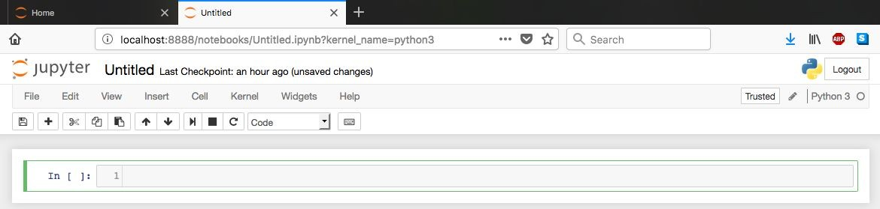



Notebook doesn’t have a title, yet.
Running Python 3

Slide 33
Running Python 3
Notebook doesn’t have a title, yet.
I’ll leave it to you to learn about the other features by reading the documentation. For now, the green-highlighted box is most important. That’s where we write Python code.

Slide 34
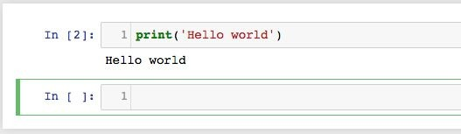
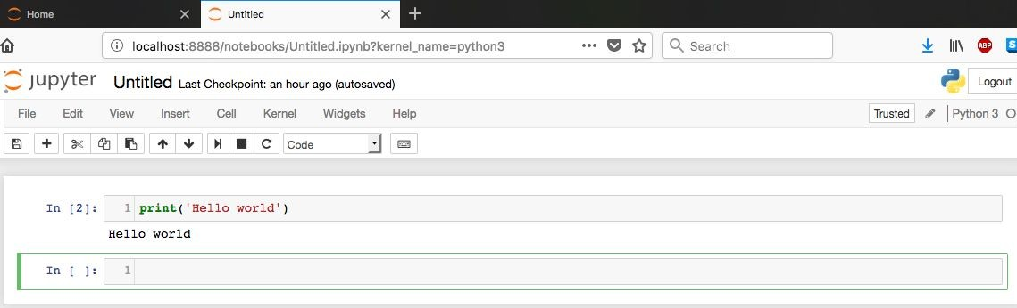
Write code in the highlighted box, then press shift+enter to run the code in that box...

Slide 35

Write code in the highlighted box, then press shift+enter to run the code in that box...
Note: can also run code by clicking the “run cell” button, but the shift+enter shortcut is a lot easier.

Slide 36

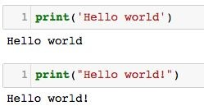
Our first function: print
Print displays whatever is inside the quotation marks.
If you haven’t already guessed, print takes a Python string and prints it. Of course, “print” here means to display a string, not literally print it on a printer!
Can also use double quotes
Note: if you know Python 2, you’ll notice that print is a bit different in Python 3. That is because in Python 2, print was a statement, whereas in Python 3, print is a function.

Slide 37








Arithmetic in Python
Use + to add numbers.
/ for division.
Use * to multiply.
Order of operations is just like you learned in elementary school.
// performs division but rounds down.
Python is weird in that it uses
** for exponentiation instead of the more common ^.
% is modulo. x%y is remainder when x is divided by y.

Slide 38
Data Types
Programs work with values, which come with different types
Examples:
The value 42 is an integer
The value 2.71828 is a floating point number (i.e., decimal number) The value “bird” is a string (i.e., a string of characters)
Variable’s type determines what operations we can and can’t perform e.g., 2*3 makes sense, but what is ‘cat’*‘dog’?
(We’ll come back to this in more detail in a few slides)

Slide 39
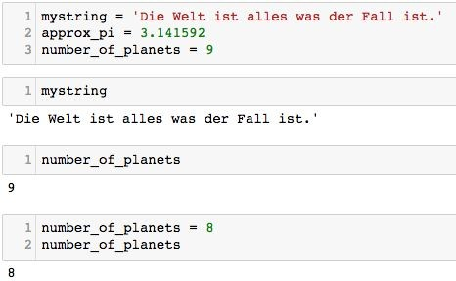

Variables in Python
Variable is a name that refers to a value
Assign a value to a variable via variable assignment
Assign values to three variables
Change the value of number_of_planets via another assignment statement.

Slide 40
Variables in Python
Note: unlike some languages (e.g., C/C++ and Java), you don’t need to tell Python the type of a variable when you declare it. Instead, Python figures out the type of a variable automatically.
Python uses what is called duck typing, which we will return to in a few lectures.
Variable is a name that refers to a value
Assign a value to a variable via variable assignment
Assign values to three variables
Change the value of number_of_planets via another assignment statement.

Slide 41
Variables in Python
Note: unlike some languages (e.g., C/C++ and Java), you don’t need to tell Python the type of a variable when you declare it. Instead, Python figures out the type of a variable automatically.
Variable is a name that refers to a value
Assign a value to a variable via variable assignment
Python variable names can be arbitrarily long, and may contain any letters, numbers and underscore (_), but may not start with a number. Variables can have any name, except for the Python 3 reserved keywords:
None continue for lambda try True def from nonlocal while and del global not with as elif if or yield assert else import pass break except in raise

Slide 42
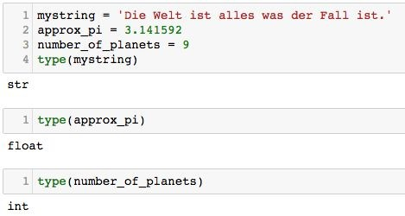
Variables in Python
Sometimes we do need to know the type of a variable
Python type() function does this for us
Recall that type is one of the Python reserved words. Syntax highlighting shows it as green, indicating that it is a special word in Python.

Slide 43
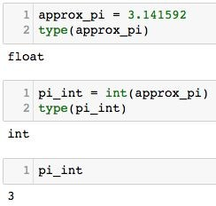
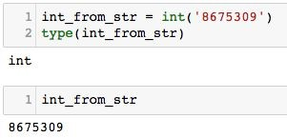
Variables in Python
Note: changing a variable to a different type is often called casting a variable to that type.
We can (sometimes) change the type of a Python variable
Convert a float to an int: Convert a string to an int:

Slide 44
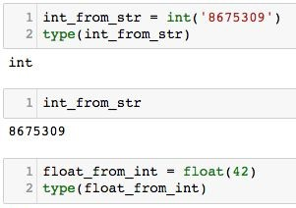
Variables in Python
Note: changing a variable to a different type is often called casting a variable to that type.
We can (sometimes) change the type of a Python variable
Convert a float to an int: Convert a string to an int:
Test your understanding: what should be the value of float_from_int ?

Slide 45
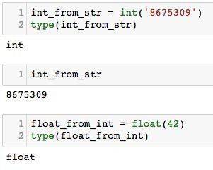
Variables in Python
Note: changing a variable to a different type is often called casting a variable to that type.
We can (sometimes) change the type of a Python variable
Convert a float to an int: Convert a string to an int:
Test your understanding: what should be the value of float_from_int ?

Slide 46
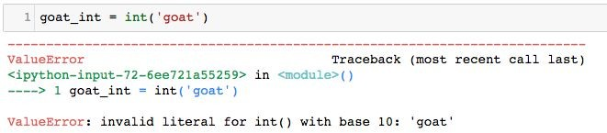
Variables in Python
We can (sometimes) change the type of a Python variable
But if we try to cast to a type that doesn’t make sense...

Slide 47
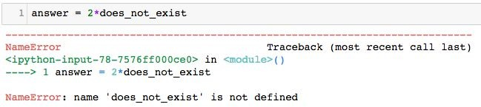
Variables in Python
Variables must be declared (i.e., must have a value) before we evaluate them
NameError signifies that Python can’t find anything (variable, function, etc) matching a given name. https://docs.python.org/3/library/exceptions.html#NameError

Slide 48
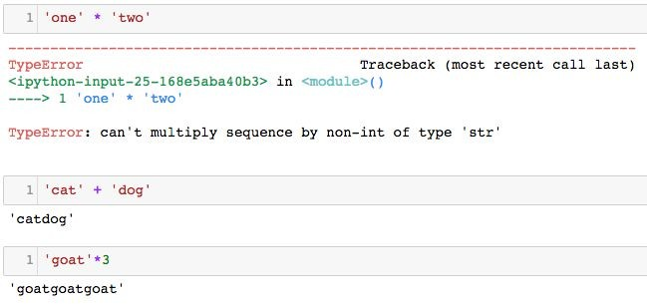


String Operations
Try to multiply two strings and Python throws an error.
TypeError signifies that one or more variables doesn’t make sense for the operation you are trying to perform. https://docs.python.org/3/librar y/exceptions.html#TypeError
Python uses + to mean string concatenation, and defines multiplication of a string by a scalar in the analogous way.

Slide 49
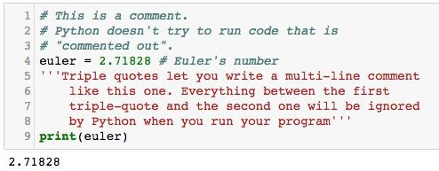
Comments in Python
Comments explain to a reader (whether you or someone else) what your code is meant to do, which is not always obvious from reading the code itself!
Comments provide a way to document your code
Good for when other people have to read your code But also good for you!

Slide 50
A parting note for the day...
Homework:
Start your homework early!
If you run into technical issues, you’ll want to have time to come get help!
A note on pace and difficulty
I aim to teach Python from scratch in this course, but…
...time spent on Python is time not spent on the stuff you’re really here for So, I expect that you are willing to work hard to keep up
If I am moving too fast, or you don’t understand something, come speak to me promptly!

